Slide 1



LISTE
{{warmup}}

Slide 2



PERGUNTE
{{question}}

Slide 3
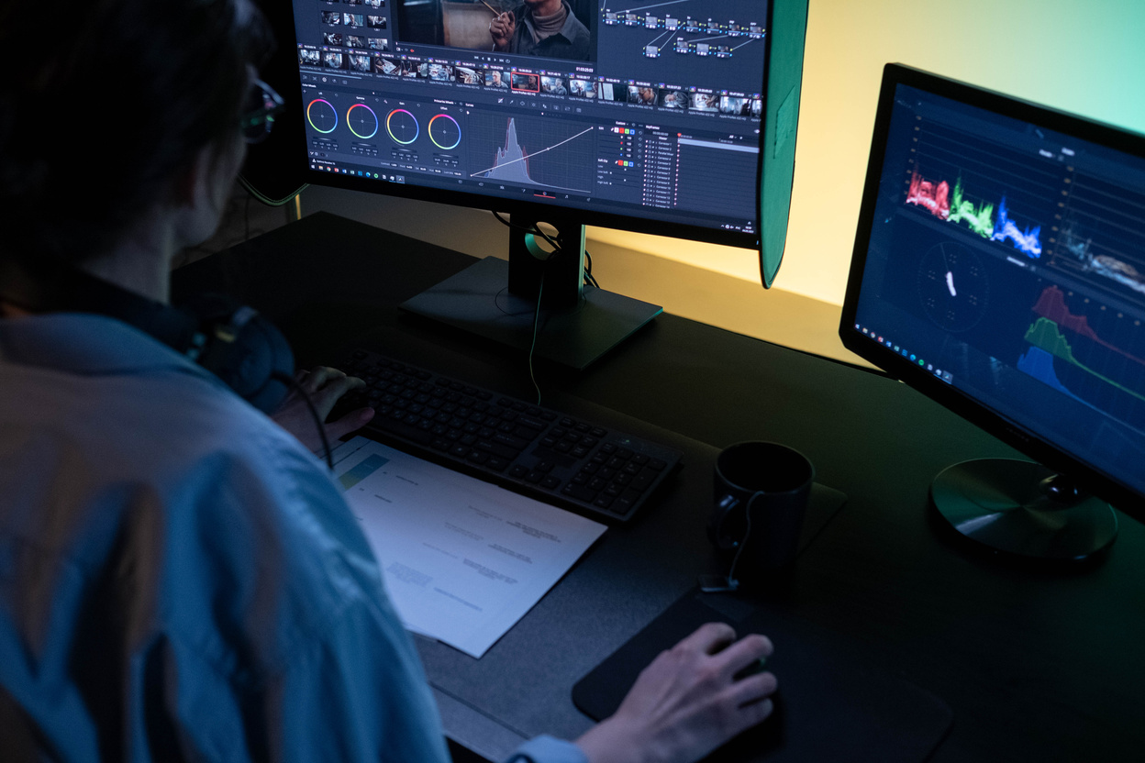
ESCOLHA
{{lead_in}}
e.g.: {{example}}

Slide 4
PERGUNTE
{{pair_work}}

Slide 5

PAGINA {{pg}}

Slide 6

FAÇA
{{production}}
e.g.: {{example_production}}

Slide 7

Revisão
{{actv1_wrap_up}}
a) {{opt1_correct}} b) {{opt2}}
{{actv2_wrap_up}}
a) {{opt1.1}} b) {{opt2.2_correct}}
{{actv3_wrap_up}}
a) {{opt3.1_correct}} b) {{opt3.2}}

Slide 8

PARA CASA
{{homework}}

